Slide 1

Section 1. Basic topics
Introduction in Logistics and Supply Chain Management
IMS – AXAN Synergy November 2019

Slide 2

Introduction in Logistics and Supply Chain Management
What logistics are ?
Why logistics are part of Supply Chain ?

Slide 3
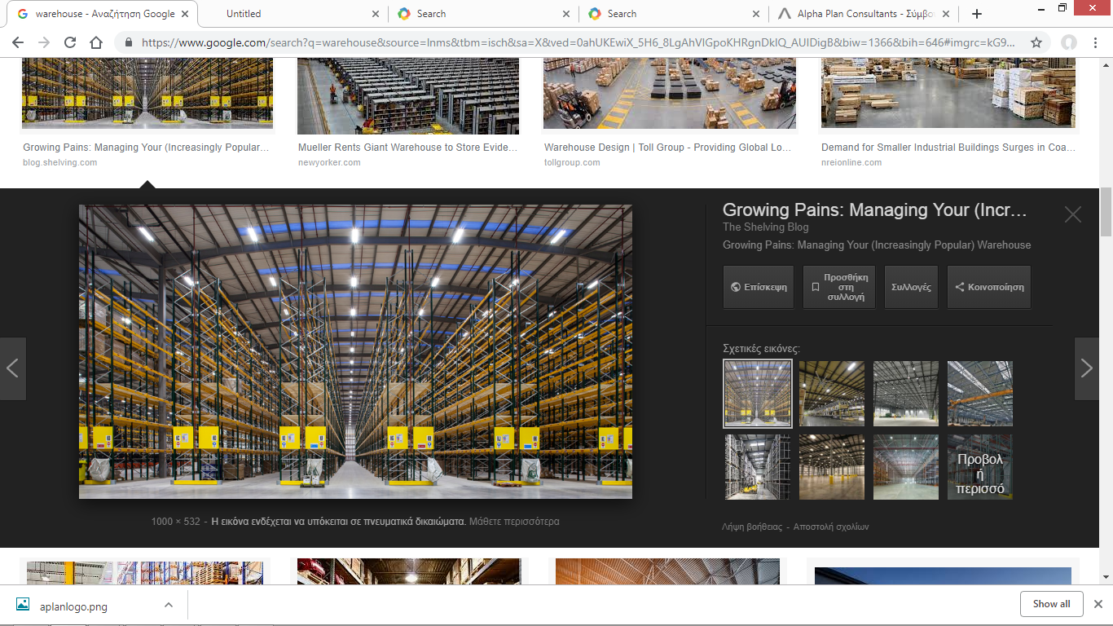
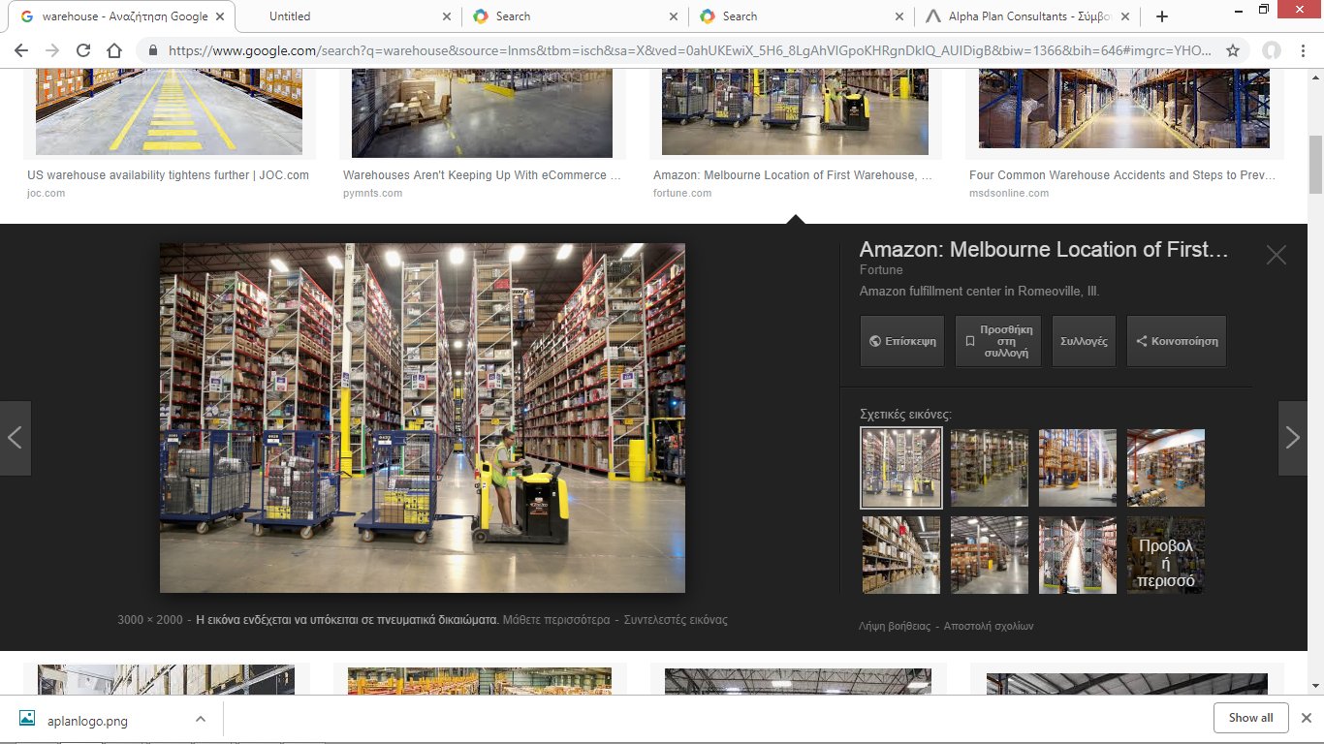
Warehouse:
The center of a company's logistics system is the warehouse. The warehouse can serve one or more business.
Types of warehouses
Warehouse basic operations

Slide 4
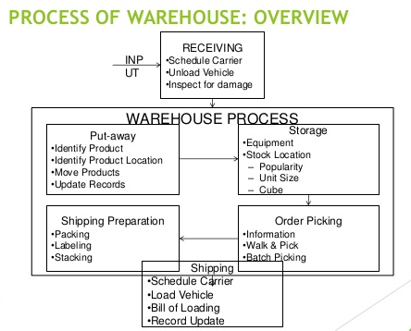
Storage
1. Entry of goods
2. Main storage
3. Execution of orders
4. Packaging and marking
5. documents control
6. Output of goods:
7. Other works

Slide 5
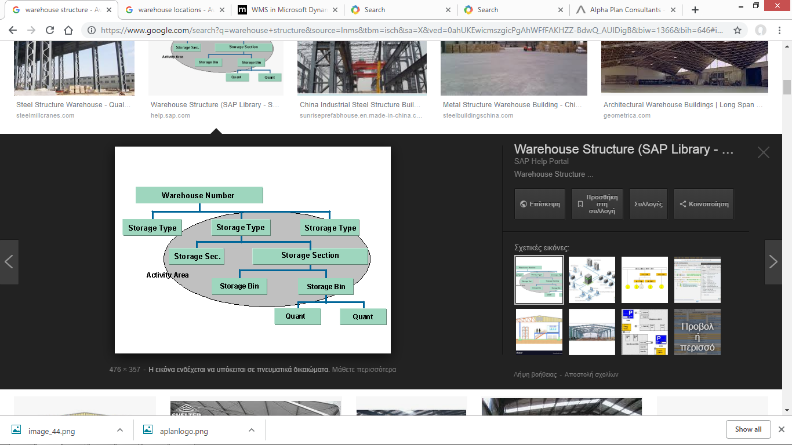
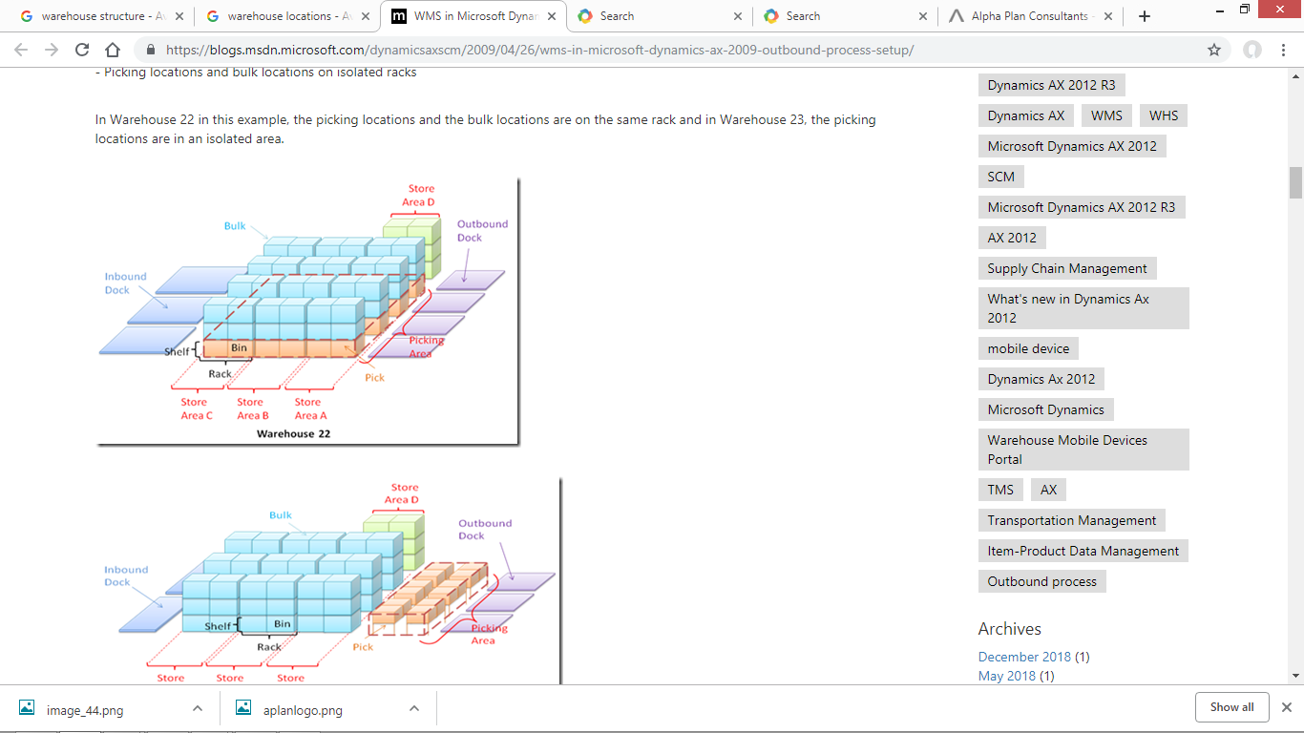
Warehouse locations
Spatial Planning of a warehouse

Slide 6
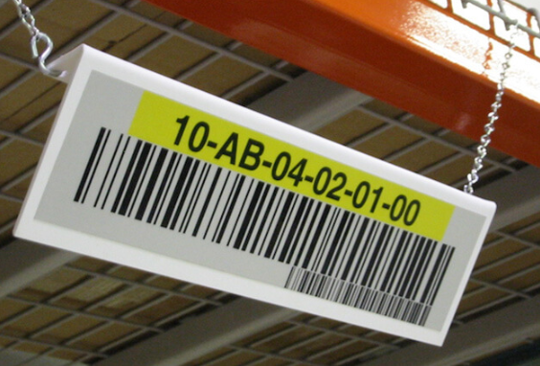
Naming warehouse locations
Ramps – Docs
Docs could have 2 dimensions. The building where they are and the unique number that define the location. (01.R.97)
Store Area
Store Area could have 2 dimensions. The building where they are and the unique number that define the location. (01.A.25)
Store Locations
Store Locations have 3 dimensions or 4 dimensions. The building, the row, the column and the level. (01.B.01.01.02)

Slide 7
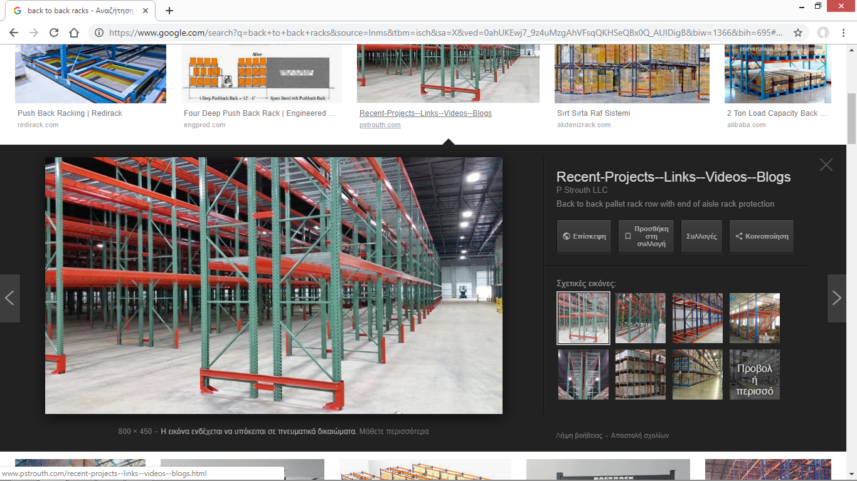
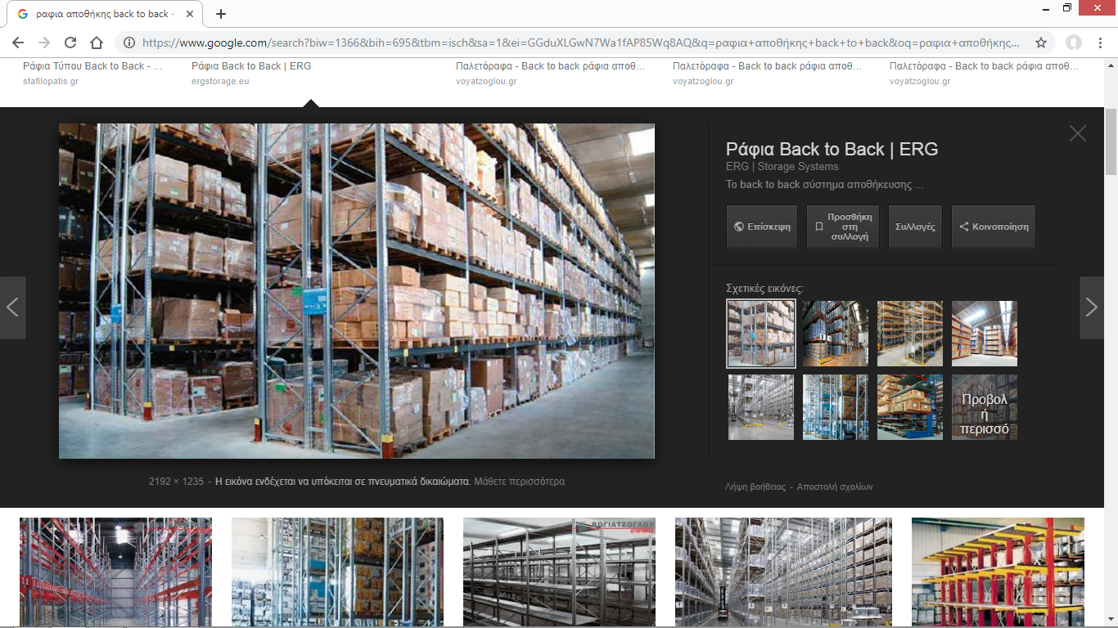
Warehouse dimensions
Building
Storage type
Row
Column
Level

Slide 8
Moving inside the warehouse
01.R01
01.B0101….
01.B0102….
01.B0103….
01.B0104….
01.B0105….
01.B0106….
Forward
01R.02
01.B0206….
01.B0205….
01.B0204….
01.B0203….
01.B0202….
01.B0201….
01.B0301….
01.B0303….
01.B0305….
01.B0307….
01.B0309….
01.B0311….
ZickZack
01R.03
01.B0302….
01.B0304….
01.B0306….
01.B0308….
01.B0310….
01.B0312….

Slide 9
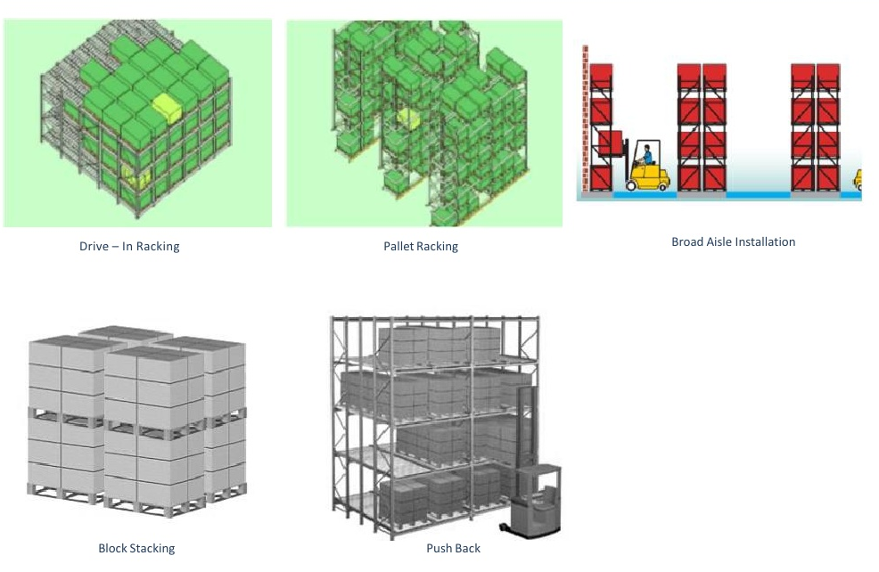
Storage Types

Slide 10
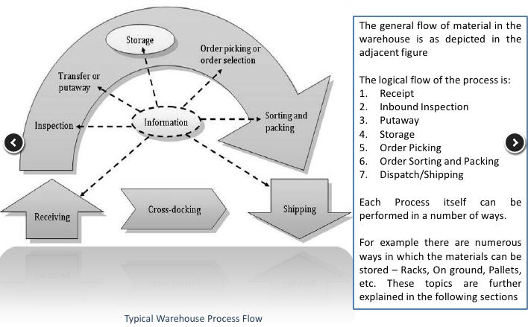
Design of processes using technologies

Slide 11
Receiving
The following steps and procedures are performed by Central Receiving staff;
a) Checking all the material/goods received against the supplier’s packing document.
b) Inspect all external packages for any visual damage. If visible damage is apparent, conduct a more thorough inspection of the contents of the packages to look for obvious damage to the item in the carton or container.
c) All completed received goods are immediately fork away to the put away central.
d) Any products found with damage packaging or variance in quantity, must be indicated on the receiving document. Picture of the damage parts are also required to be taken for record purposes. Report the damage to the proper authority in the organization.

Slide 12
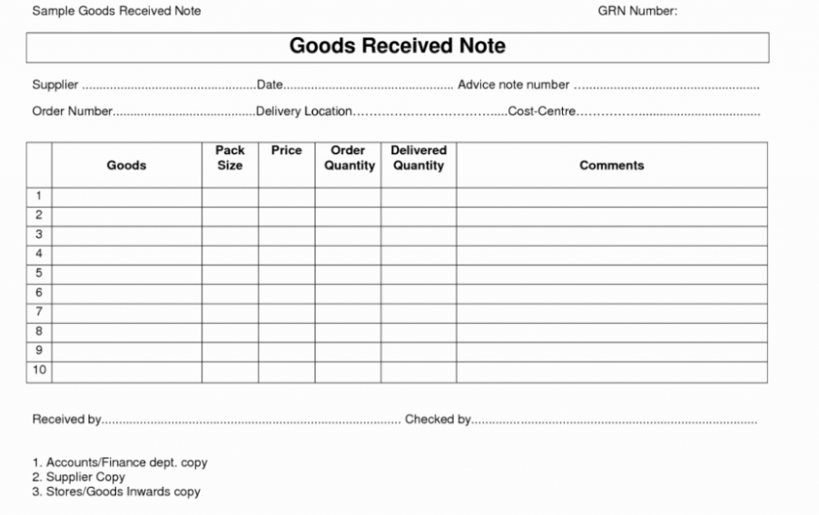

Slide 13
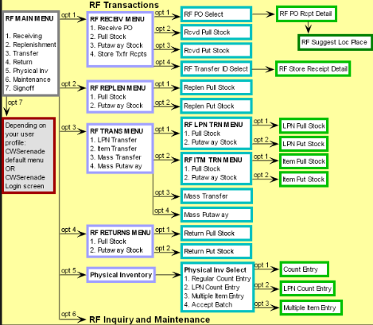

Slide 14
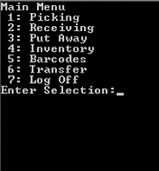
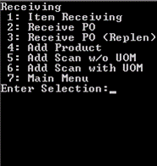
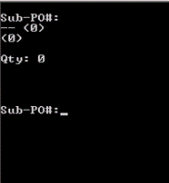
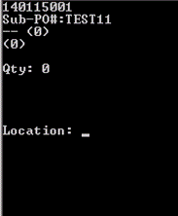
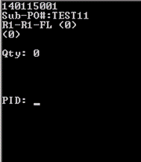
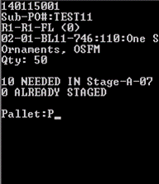
Receiving via RF
Pending on receiving type

Slide 15
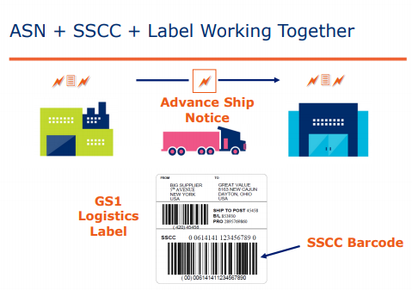
Single(Serial) Shipment Container Code (SSCC) – The Logistics Unit
A Logistics Unit, e.g. pallet, container etc. are made up of identical or different Units
It is created for the purpose of storage and / or transportation of products in logistics chain. For encoding it is used the 18-digit Serial Code Logistics Unit - SSCC (Serial Shipping Container Code) and is depicted by EAN-128.

Slide 16
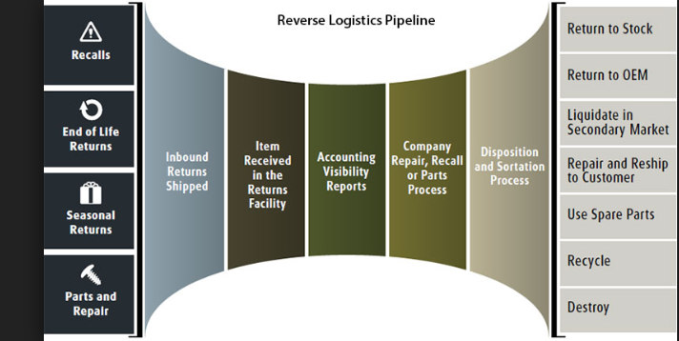
Returns

Slide 17
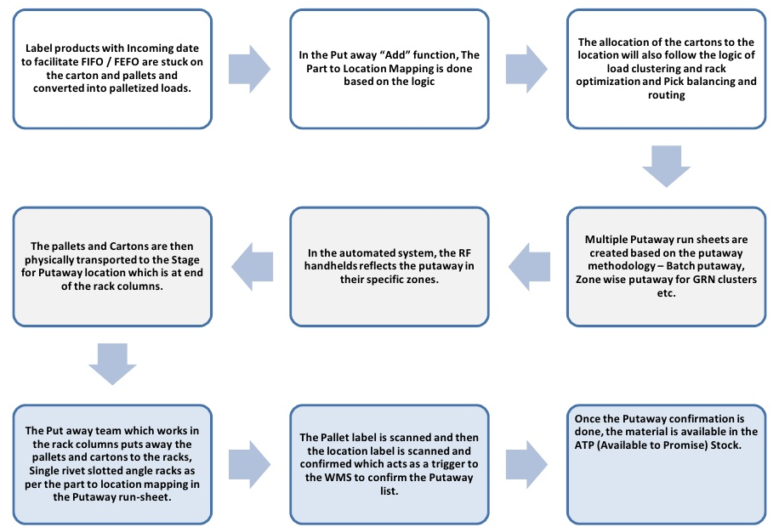
Storage – Put Away

Slide 18
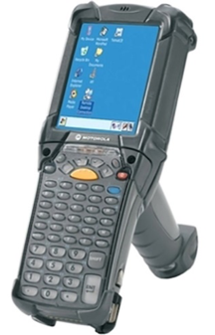
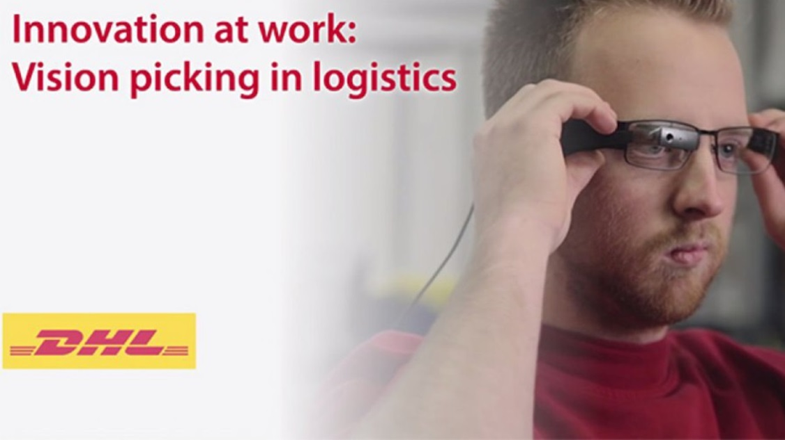

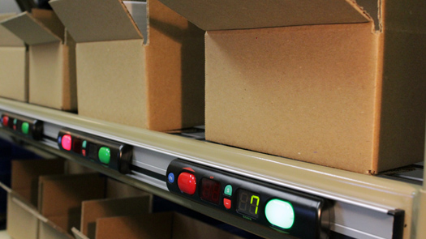
Picking
With hardcopy picking list
With RF Scanner
Pick 2 Light
Voice picking
Vision picking

Slide 19
Type of Picking
Types of order picking include:
piece picking or picker to part method: the order picker(s) move(s) to collect the products necessary for one order. This is commonly seen in distribution centres for retail chains whereby a shop will require a great many replenishment goods. A picker may pick all or part of the replenishment for one shop.
zone picking method: each order picker is assigned to one specific zone and will only realize order picking within this zone. For instance, in an electrical retail environment, both small and large items may be required and a picker on an electric vehicle such as a powered pallet truck (PPT) or an order picker vehicle may pick large and heavy items whereas a foot picker may pick small and light ones from another part of the warehouse. Eventually the two picks are collated.
wave picking method: (Wave picking) the order picker(s) move(s) to collect the products necessary for several orders
sorting systems method: no movement of the order picker(s), the products are brought to him by an automatic system (conveyor system, automatic storage ...).
pick to box method:The WMS direct the operator to pick the sku from a storage bin or a transportation box and to put it inside the shipping box or into a box assigned to the sales order.

Slide 20
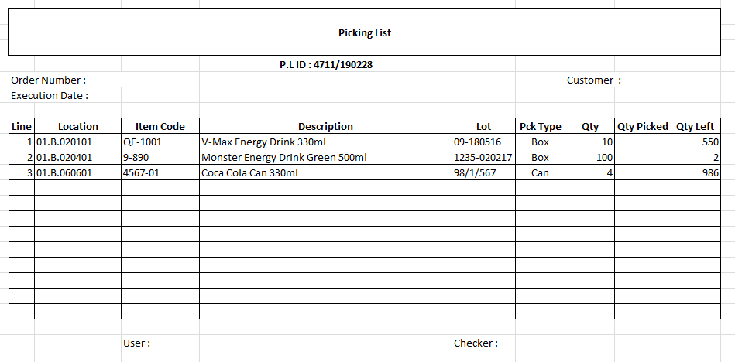
Picking by hardcopy picking list

Slide 21
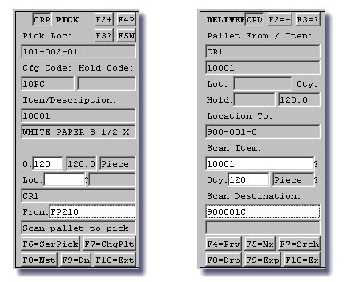
Picking with RF Scanner
https://www. youtube.com/watch?v=R1oLUMsijhY

Slide 22
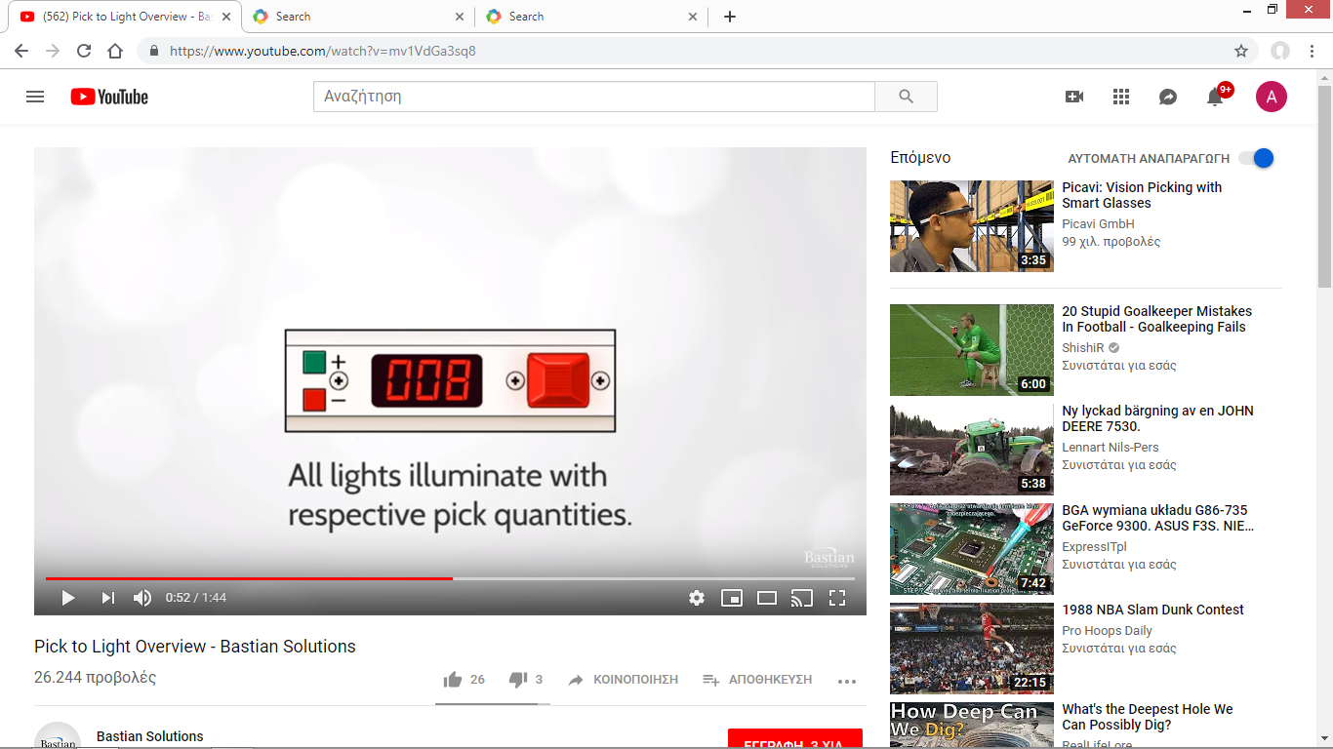
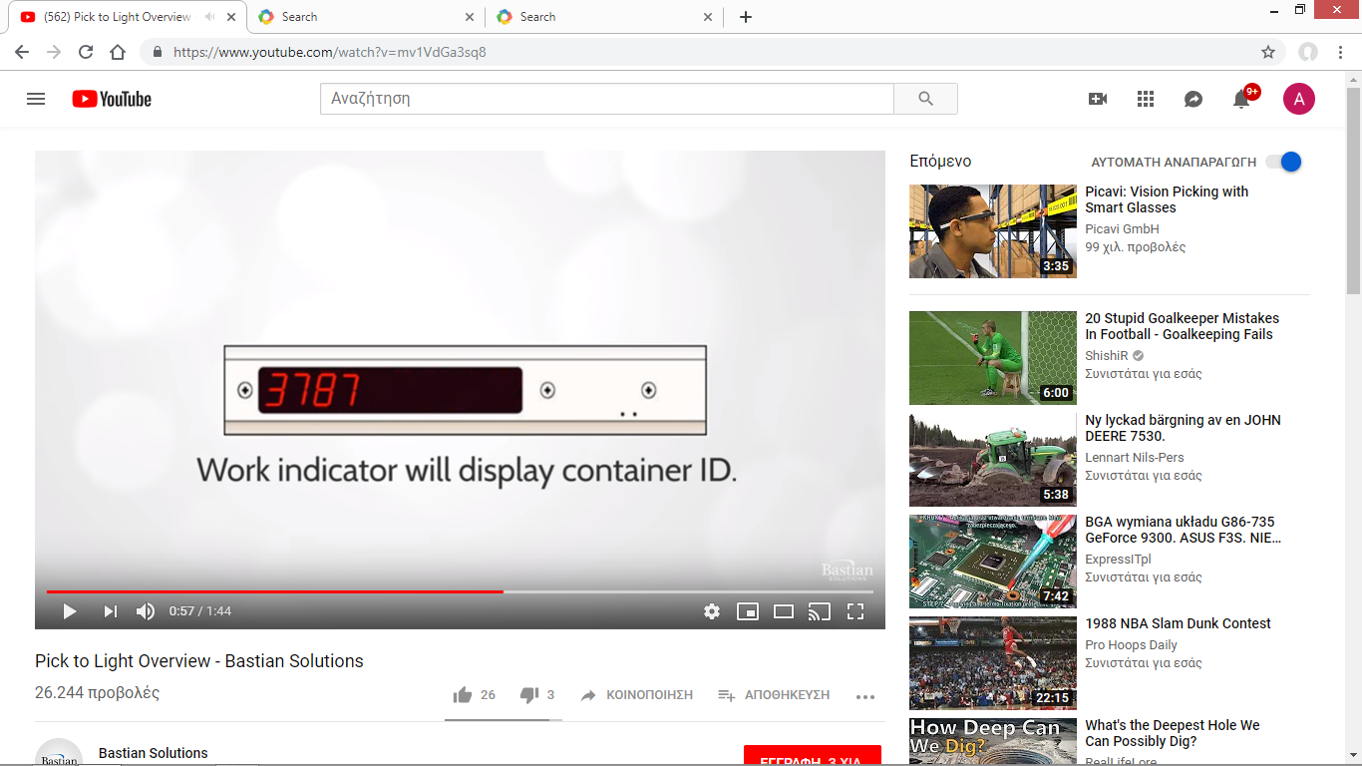
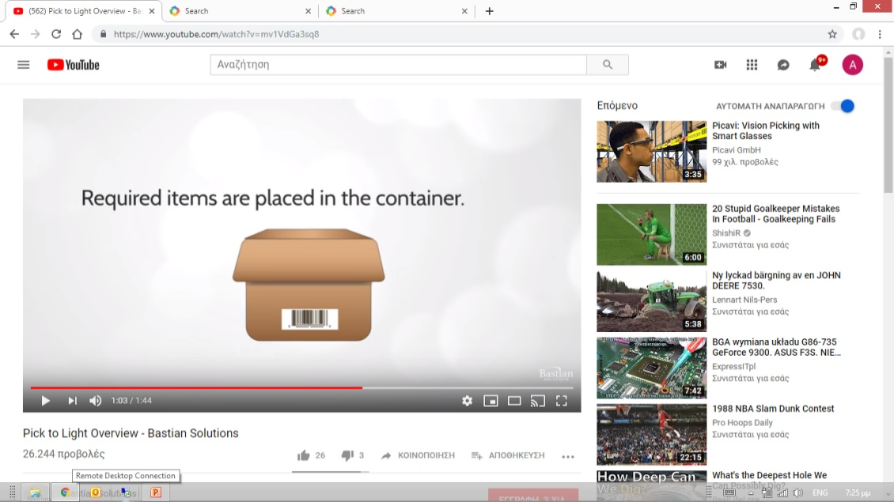
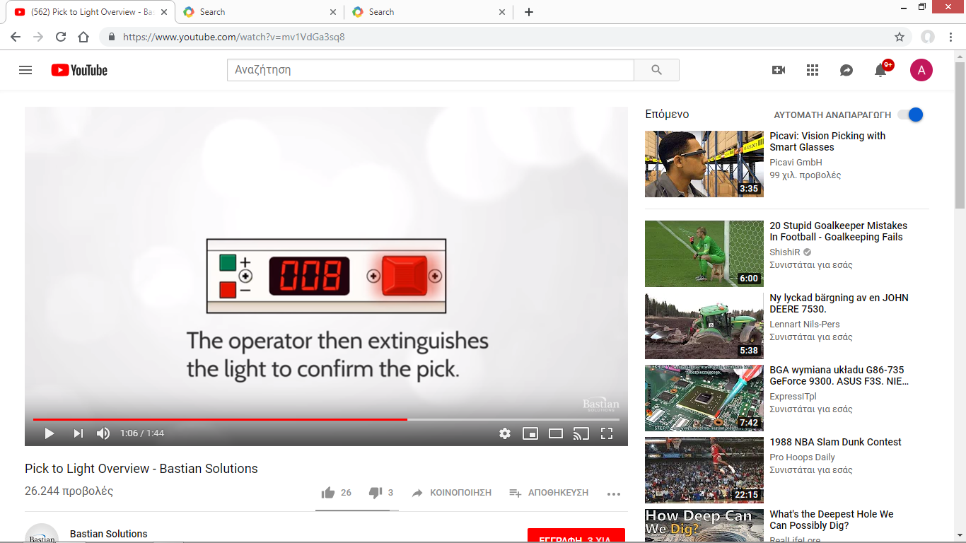
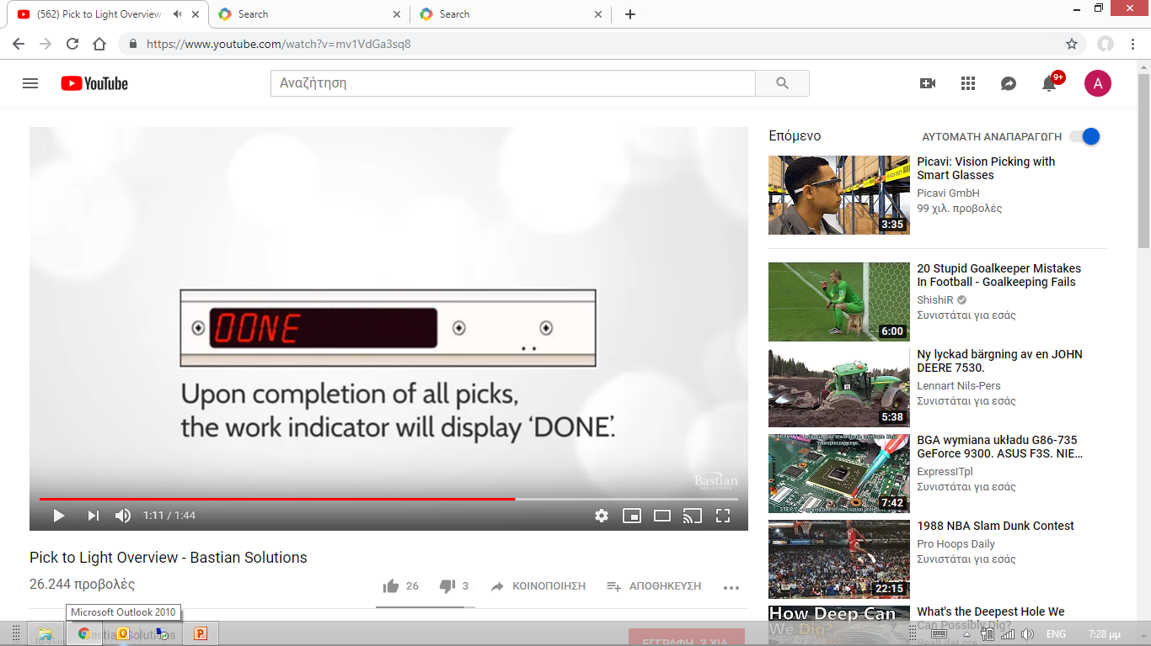
Pick 2 Light

Slide 23
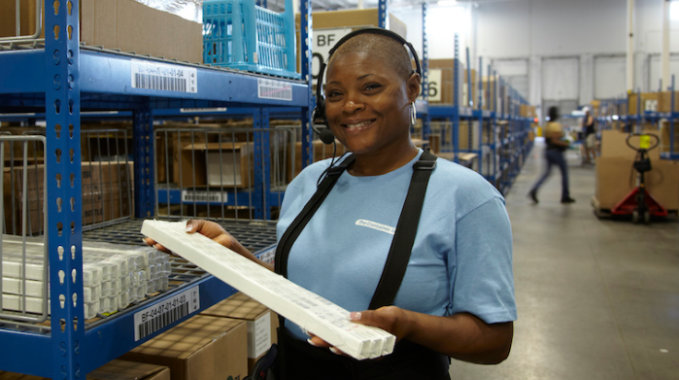
Voice picking
https://www.youtube.com/watch?v=0Zbw4vY5NKU

Slide 24
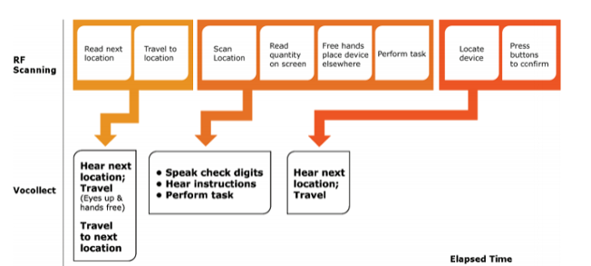
RF picking VS Voice picking

Slide 25
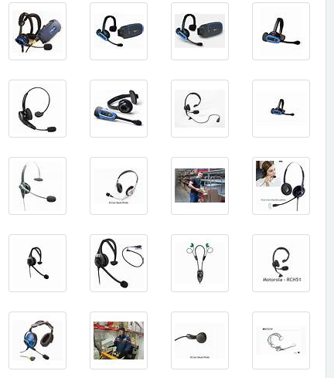
Voice picking headset

Slide 26
Voice picking phonetics orders
Ανανέωση / Ananeosi / Refresh : Refresh and recheck quantity in the location after a refill.
Έξοδος / Exodos / Exit : Exit from the system.
Επόμενη θέση / Epomeni Thesi / Next location : When the picking location is empty the system informs for refill and it give us new location to pick.
Θέση / Thesi / Location : We use this order when we didn’t hear clear the location where the system is sending us. So system repeat the location name.
Κλείσιμο εργασίας / Klisimo ergasias / Task close : We use this order to declare that even the fact that the picking list is not finished our pallet is full.
Μηδενισμός / Midenismos / Initialize : We use this word to inform the system that even the system say there is quantity of an item in the location there is not. This order initialize the location.
Πείτε το πάλι / Pite to pali / Repeat : In case we didn’t hear what the system say.
Σπασμένα/ Spasmena / Dameged : In case we pick boxes which are open and some pieces are missing we can pick the box by declaring that and the number of pieces we put in the order.
Υπόλοιπο / Ipolipo / Remaining : Inform us for the number of locations and boxes have left to complete the picking list.

Slide 27
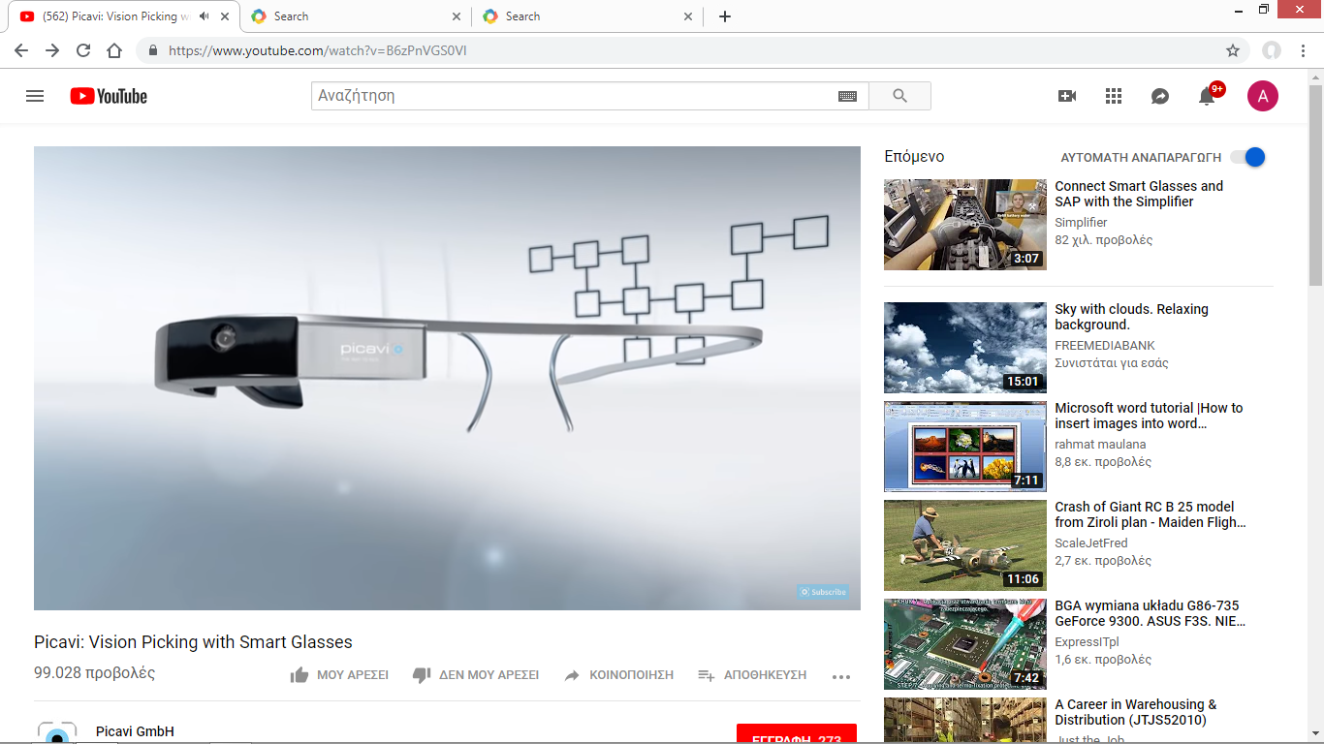
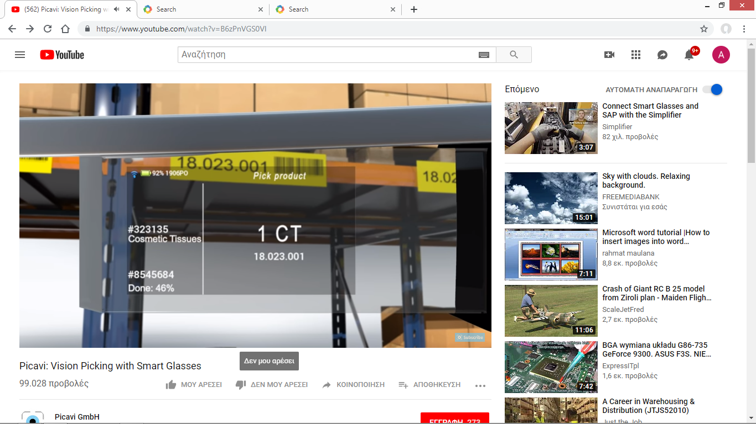
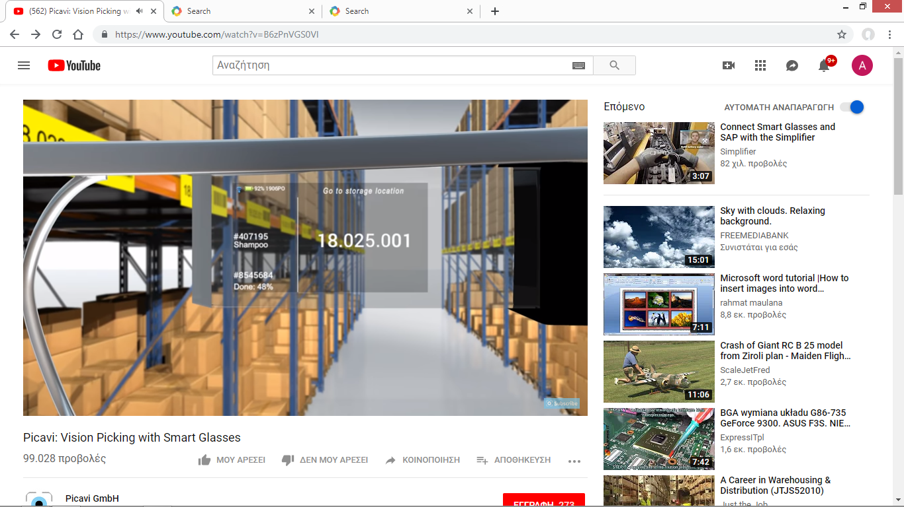
Visual picking
https://www.youtube.com/watch?v=B6zPnVGS0VI

Slide 28
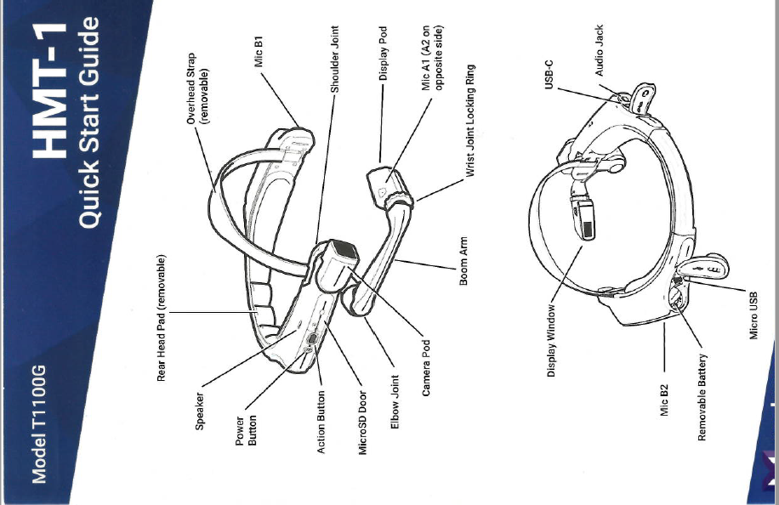

Slide 29

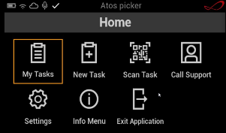
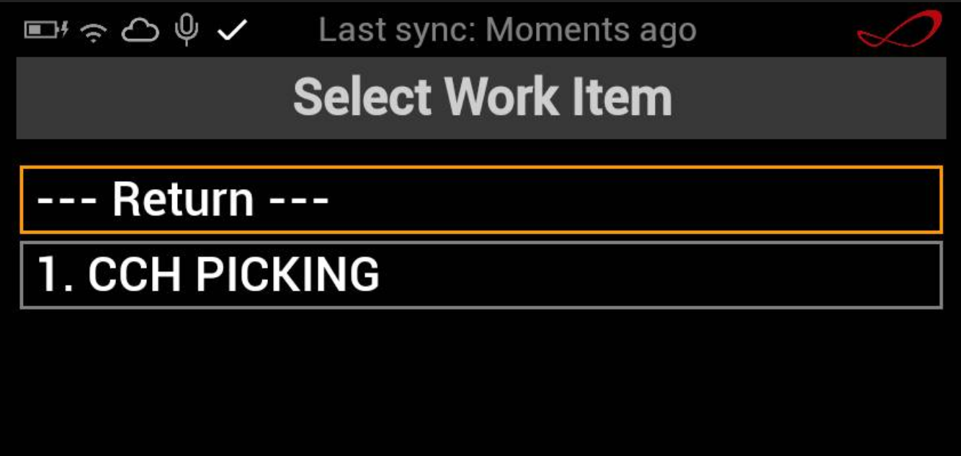
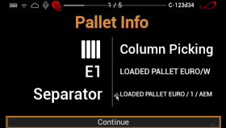
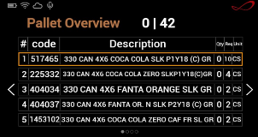
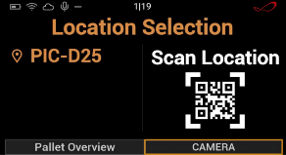
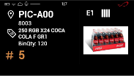
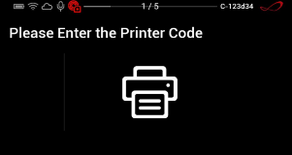
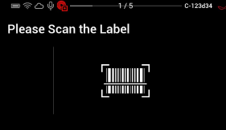
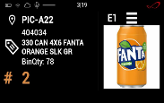
Vision Picking Application - Flow

Slide 30
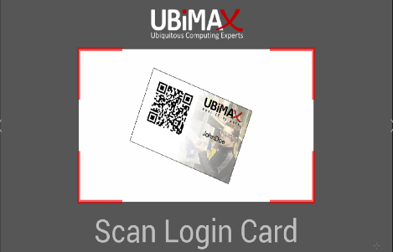

Vision Picking Application - Log On
The user logs in by scanning QR code containing his personal credentials.

Slide 31
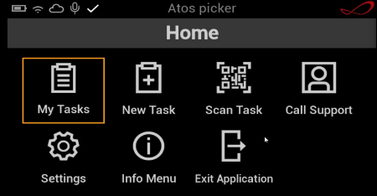
Vision Picking Application - Start Vision Picking
Voice command “My Tasks”
Voice command “Select one”

Slide 32
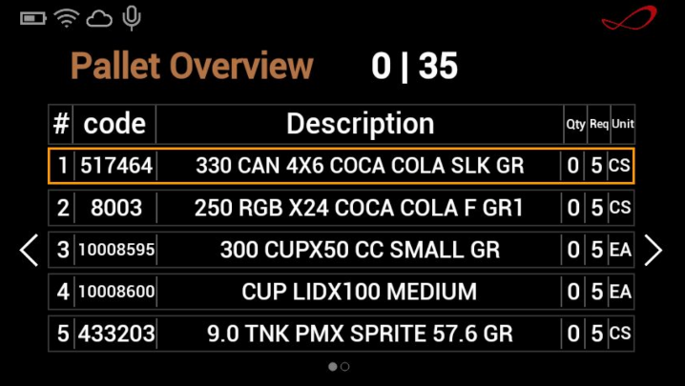

Vision Picking Application – Pallet Overview
Screen shows all materials within a pallet assigned
for Vision Picking.
Voice command “Select #”
Example:
Voice Command “Select 2”
total cases to be picked
total requested qty per material
# of pages
already picked

Slide 33



Vision Picking Application - Picking
*shown when active pallet qty could not cover the remaining qty to be picked
Total bin quantity
Quantity to be picked
Total bin quantity
Can be picked from active pallet
Already picked
Total to be picked

Slide 34

Vision Picking Application – Print Label
After all items within a pallet are picked (canceled), user is forced to scan printer QR code.

Slide 35

Vision Picking Application – Print Label
Once the print out is successfully obtained, the picker should scan the SSCC code that is available on the label.
Voice command “Camera”

Slide 36

Vision Picking Application – Pre-stage (Loading Ramp) bin
After scanning the pallet label, Vision Picking application shows pre-stage bin – Loading Ramp where the picker should place the ready pallet.
Once the pallet is placed in the pre-stage bin:
Voice command “Continue”

Slide 37
Replenishment
Purpose
Replenishment is the process of refilling picking locations with items.
Example : There is a rack with three compartments (Upper, middle and lower)
When the stock is manually picked by a worker in warehouse, it is always easier to pick it from the lower compartment than picking it from the middle or the upper compartment.
Now consider a scenario that the stock at the lowest compartment is consumed. And there is a new pick request for the stock. The person who would carry the stock now needs to take extra efforts to access the stock at the higher compartments. If this continues then it will be tedious and time consuming.
This is where the replenishment is important.
Whenever the stock in the lower compartment is minimum, we fill the compartment with the stock from middle/upper compartments.

Slide 38
Replenishment
What is the picker doing when a picking location is empty :
1. Skip the task and goes to next location
Warehouse’s where the way that the order is palletized is not important.
Minus : When the specific order picking finish we have to return to the locations we skip
Plus : We don’t spend time waiting for replenishment
2. Wait for goods arrival.
Warehouse’s where the way the order is palletized is important
Minus : We spend time waiting
Plus : We don’t return to same location twice.

Slide 39

The picking flow

Slide 40
Packing – Wrapping
Pallet wrapping
https://www.youtube.com/watch?v=ZuYQRratfVU
Order Packing
Order packing is the warehouse process of consolidating all items in a sales order into an appropriate container and getting it fully prepared for shipment.
Loading

Slide 41
Loading

Slide 42

Other actions
Location stock check
Inventory search
Cycle count
Moving stock

Slide 43

Location stock check
Define location
Physical count
Act as your instructions say

Slide 44
Inventory search
“Inventory checking" is the physical verification of the quantities and condition of items held in an inventory or warehouse.
Define Item code (SKU)
Visit locations
Physical count
Act as your instructions say

Slide 45

Cycle and inventory counts
A cycle count is an inventory auditing procedure, which falls under inventory management, where a subset or all of inventory, in a specific location or in the whole warehouse, is counted on a specified day.
The purpose of cycle counting is to verify the inventory accuracy and even though it is not an adequate procedure to be used to correct inventory errors, it is an adequate way to identify the root causes of inventory errors.

Slide 46
Section 2. Health and Safety
Introduction in Logistics and Supply Chain Management

Slide 47

https://www.youtube.com/watch?v=WHQlylzS1rc

Slide 48

Personal Protection Equipment
Personal protective equipment (PPE) is protective clothing, helmets, goggles, or other garments or equipment designed to protect the wearer's body from injury or infection.

Slide 49
A leading cause of back injury at work is lifting or handling objects incorrectly.
Learning and following the correct method for lifting and handling heavy loads can help prevent injury and avoid back pain.
Check out these safe lifting and handling tips, recommended by the Health and Safety Executive.
Think before you lift
Plan the lift. Where is the load going to be placed? Will help be needed with the load? Is there equipment you could use, such as a hoist, that could help with the lift? Remove obstructions, such as discarded wrapping materials. For long lifts, such as from floor to shoulder height, consider resting the load midway on a table or bench to change your grip on it.
Keep the load close to the waist
Keep the load close to the waist for as long as possible while lifting to reduce the amount of pressure on the back.
Keep the heaviest side of the load next to the body. If closely approaching the load is not possible, try to slide it towards the body before trying to lift it.
Adopt a stable position
Your feet should be apart with 1 leg slightly forward to maintain balance (alongside the load, if it's on the ground). Be prepared to move your feet during the lift to maintain a stable posture. Wearing over-tight clothing or unsuitable footwear, such as high heels or flip flops, may make this difficult.
Ensure a good hold on the load
Where possible, hug the load close to the body. This should help you make a stronger and more solid lift than gripping the load tightly with the hands only.
Do not bend your back when lifting
A slight bending of the back, hips and knees at the start of the lift is preferable to either fully flexing the back (stooping) or fully flexing the hips and knees – in other words, fully squatting.
Do not bend the back any further while lifting
This can happen if the legs begin to straighten before starting to raise the load.
Do not twist when you lift
Avoid twisting the back or leaning sideways, especially while the back is bent. Keep your shoulders level and facing the same direction as the hips. Turning by moving your feet is better than twisting and lifting at the same time.
Look ahead
Keep your head up when handling the load. Look ahead, not down at the load, once it has been held securely.
Move smoothly
Do not jerk or snatch the load as this can make it harder to keep control and increases the risk of injury.
Know your limits
Do not lift or handle more than you can easily manage. There's a difference between what people can lift and what they can safely lift. If you're in doubt, seek advice or get help.
Lower down, then adjust
Put the load down and then adjust. If you need to position the load precisely, put it down first, then slide it into the desired position.

Slide 50

Lines, corridors and routes in the warehouse
Defining Ramps

Slide 51

Lines, corridors and routes in the warehouse
Pallet overflow in picking area

Slide 52

Lines, corridors and routes in the warehouse
Pedestrian route

Slide 53




Lines, corridors and routes in the warehouse

Slide 54
Signing in the warehouse
Workers should be properly aware of safety procedures on the job as well as any potential hazards in the warehouse. Signage available to distribution centers include forklift safety signs, clearance height and capacity signs, quality control signs, safety reminder signs, and more.
Aisle and pole marking signs help forklift drivers navigate around corners and in tight spots without damaging their equipment and the storage racks and shelves.
Improperly labeled and managed warehouses can be a breeding ground for workplace injuries. Signs should never be taken for granted when it comes to workplace safety.

Slide 55


Signing in the warehouse

Slide 56




Signing in the warehouse

Slide 57

Signing in the warehouse

